Slide 1
The Artificial Intelligence trainer
เทรนเนอร์ อัจฉริยะ
Presented by: Aditep Campira

Slide 2
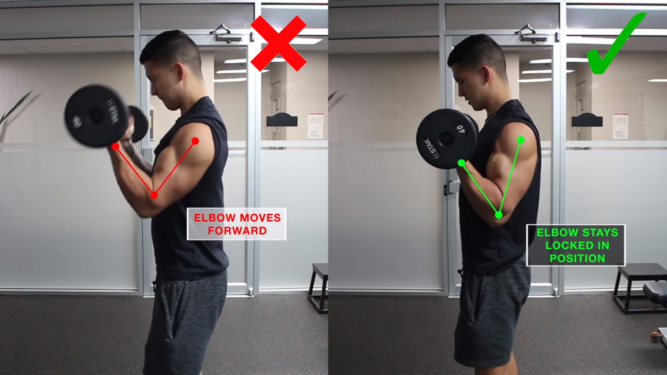
Barbell curl
Barbell curl

Slide 3
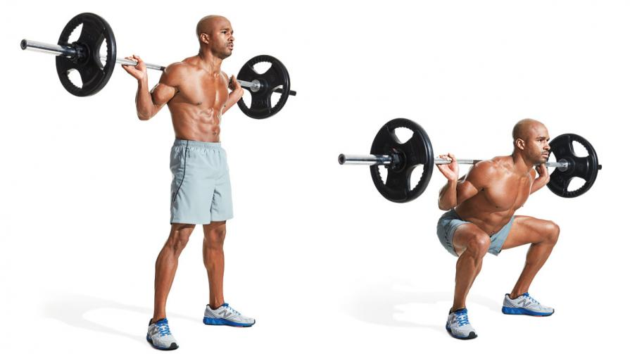
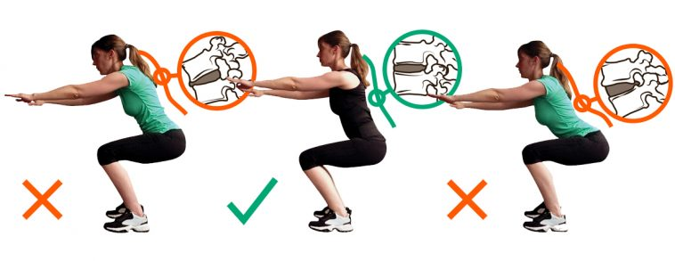

Slide 4
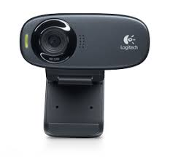
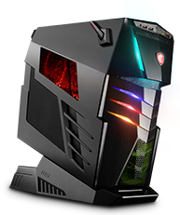
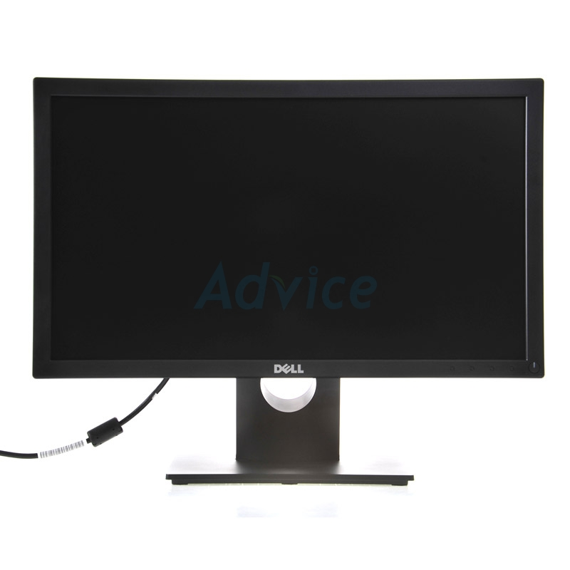
Input
(Webcam , Pictures , Vdo)
(Desktop application)
Process
(AI)
Output

Slide 5
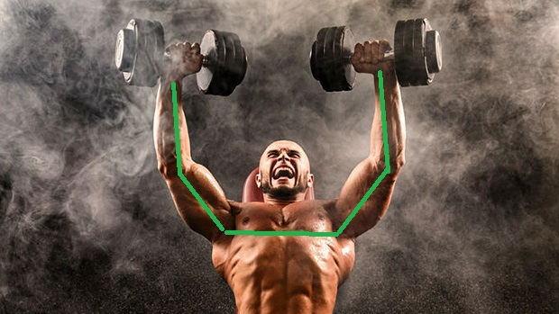
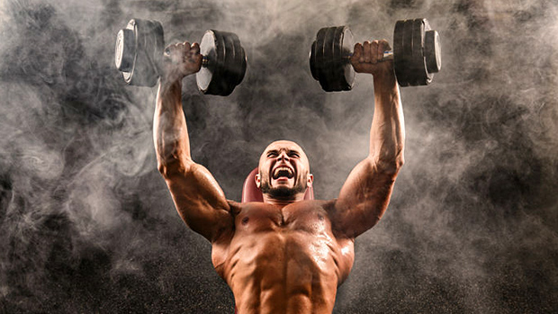
"pose_keypoints_2d":[582.349,507.866,0.845918,746.975,631.307,0.587007,...],
"face_keypoints_2d":[468.725,715.636,0.189116,554.963,652.863,0.665039,...],
"hand_left_keypoints_2d":[746.975,631.307,0.587007,615.659,617.567,0.377899,...],
"hand_right_keypoints_2d":[617.581,472.65,0.797508,0,0,0,723.431,462.783,0.88765,...]
"pose_keypoints_3d":[582.349,507.866,507.866,0.845918,507.866,746.975,631.307,0.587007,...],
"face_keypoints_3d":[468.725,715.636,715.636,0.189116,715.636,554.963,652.863,0.665039,...],
"hand_left_keypoints_3d":[746.975,631.307,631.307,0.587007,631.307,615.659,617.567,0.377899,...],
"hand_right_keypoints_3d":[617.581,472.65,472.65,0.797508,472.65,0,0,0,723.431,462.783,0.88765,...]
Webcam
Openpose
Data
Model 1
Error 10.3%
Data
Dev set
Model 1
Model 2
Error 11.5%
1
2
3
Hidden Layer
Output Layer
Development set
Deep Learning
Training set
Error 10.3%
Model 1
Test set
Model
Test set

Slide 6

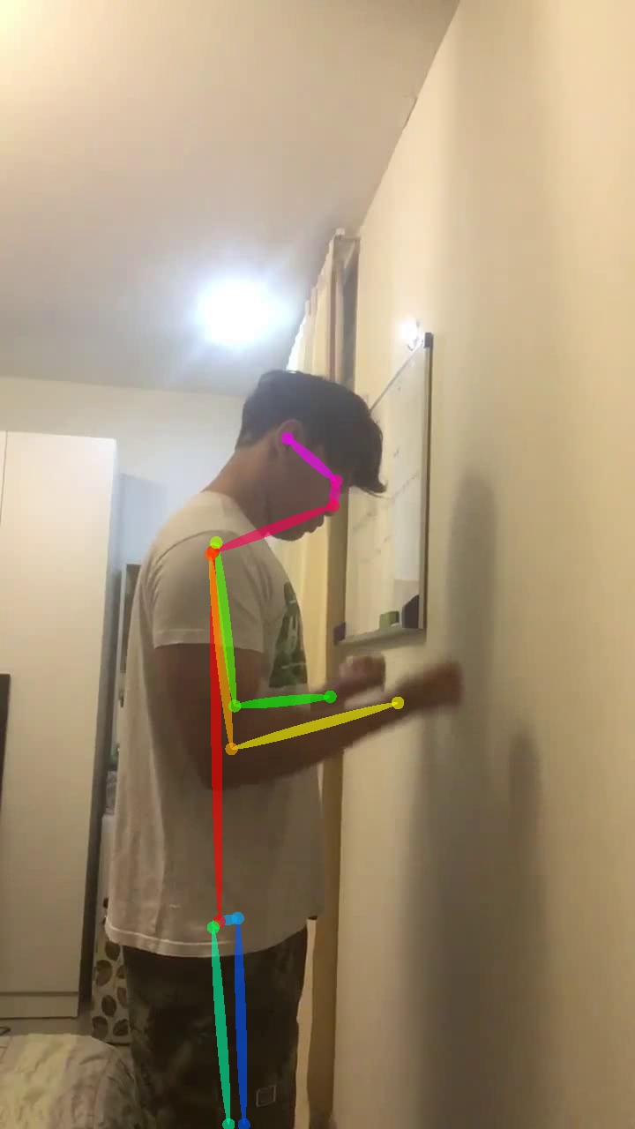
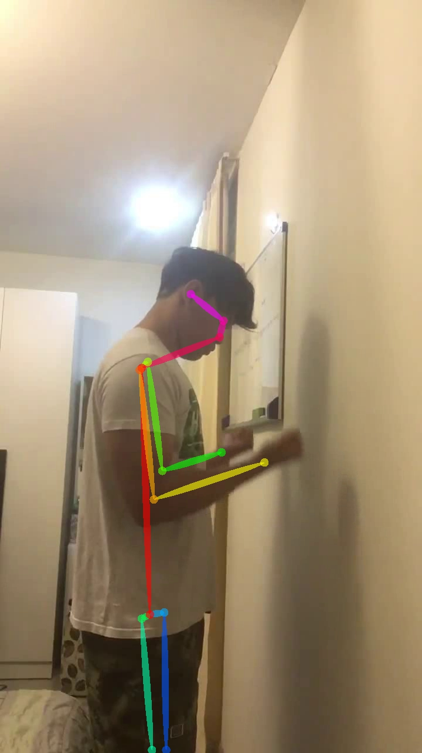
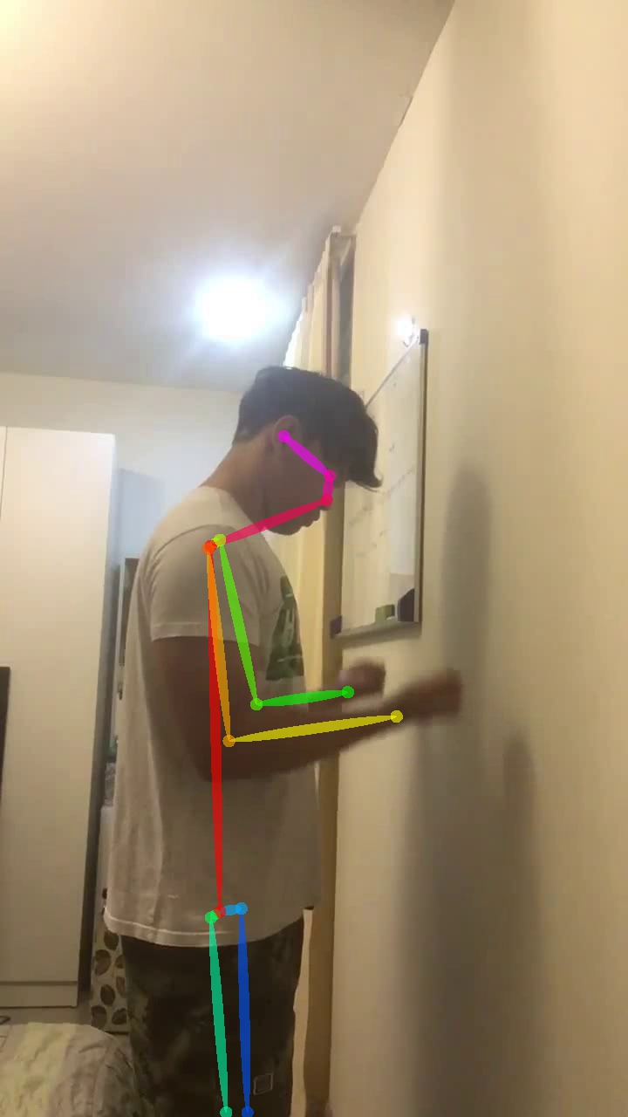
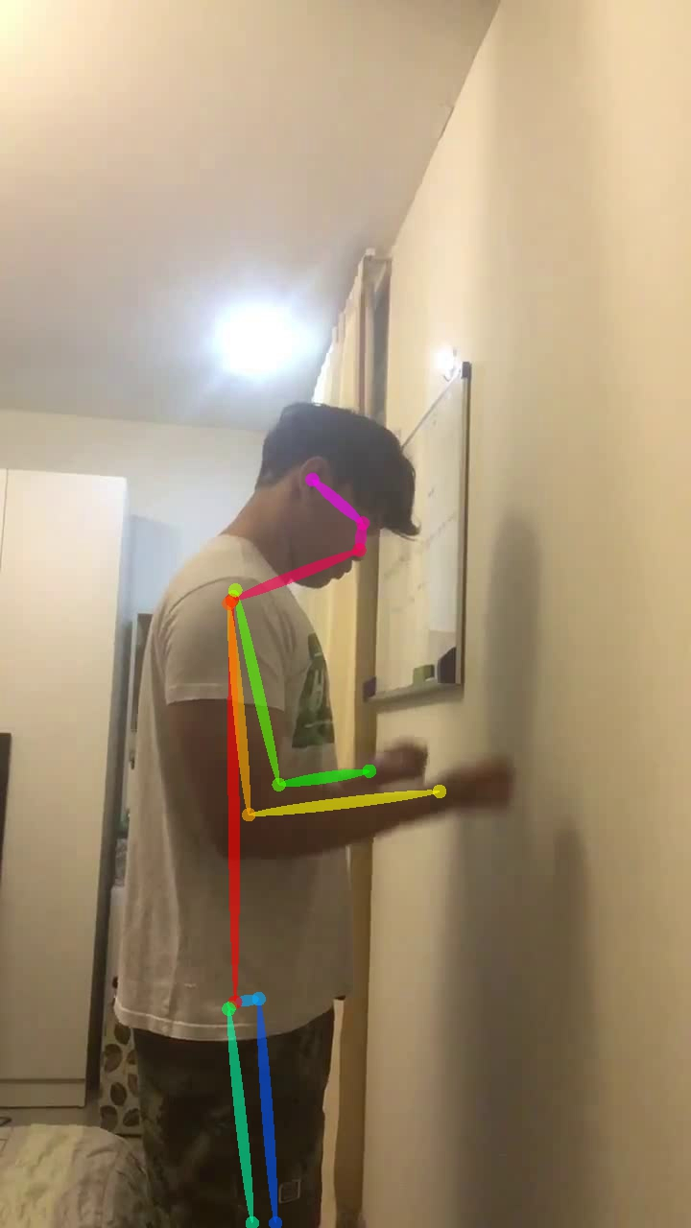
ตัวอย่างการใช้ Openpose

Slide 7
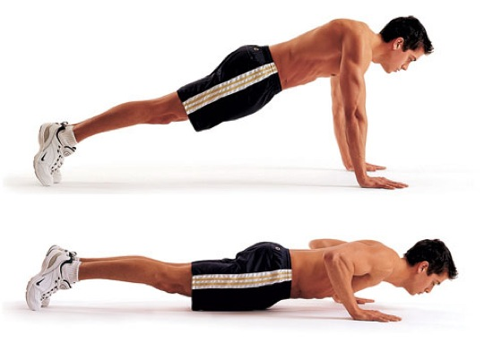
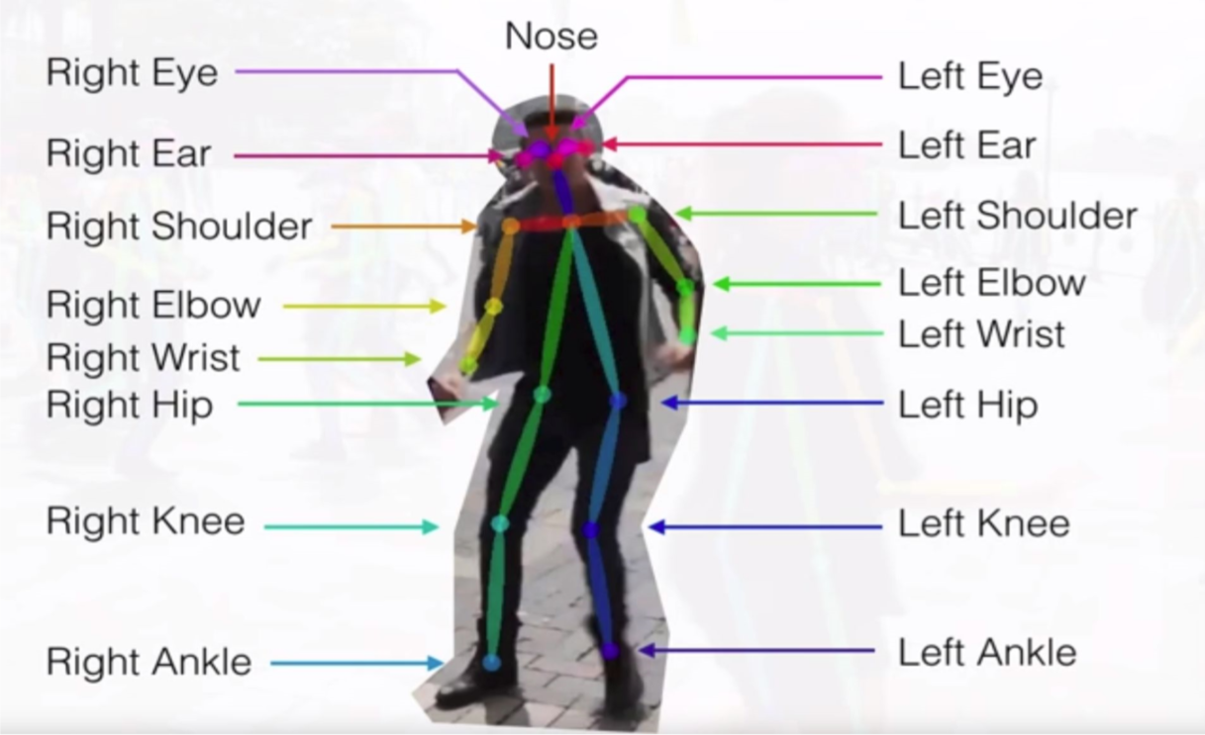
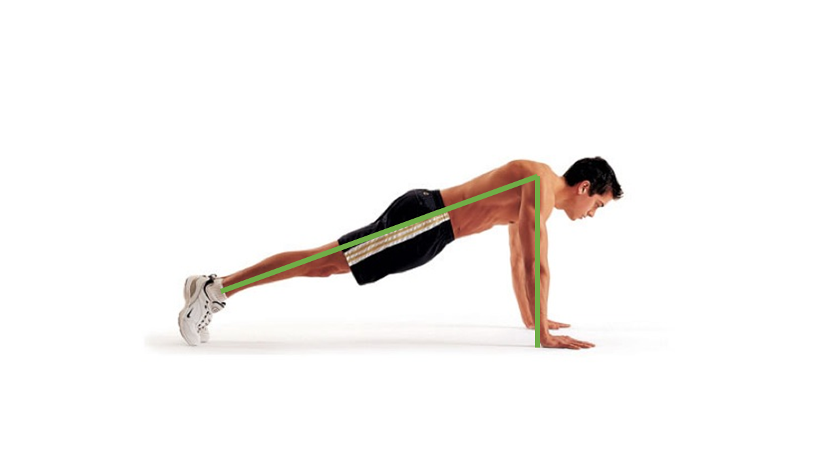
"pose_keypoints_2d":[582.349,507.866,0.845918,746.975,631.307,0.587007,...],
"face_keypoints_2d":[468.725,715.636,0.189116,554.963,652.863,0.665039,...],
"hand_left_keypoints_2d":[746.975,631.307,0.587007,615.659,617.567,0.377899,...],
"hand_right_keypoints_2d":[617.581,472.65,0.797508,0,0,0,723.431,462.783,0.88765,...]
"pose_keypoints_3d":[582.349,507.866,507.866,0.845918,507.866,746.975,631.307,0.587007,...],
"face_keypoints_3d":[468.725,715.636,715.636,0.189116,715.636,554.963,652.863,0.665039,...],
"hand_left_keypoints_3d":[746.975,631.307,631.307,0.587007,631.307,615.659,617.567,0.377899,...],
"hand_right_keypoints_3d":[617.581,472.65,472.65,0.797508,472.65,0,0,0,723.431,462.783,0.88765,...]
Data
Input
Openpose
Model 1
Model 2
Output

Slide 8
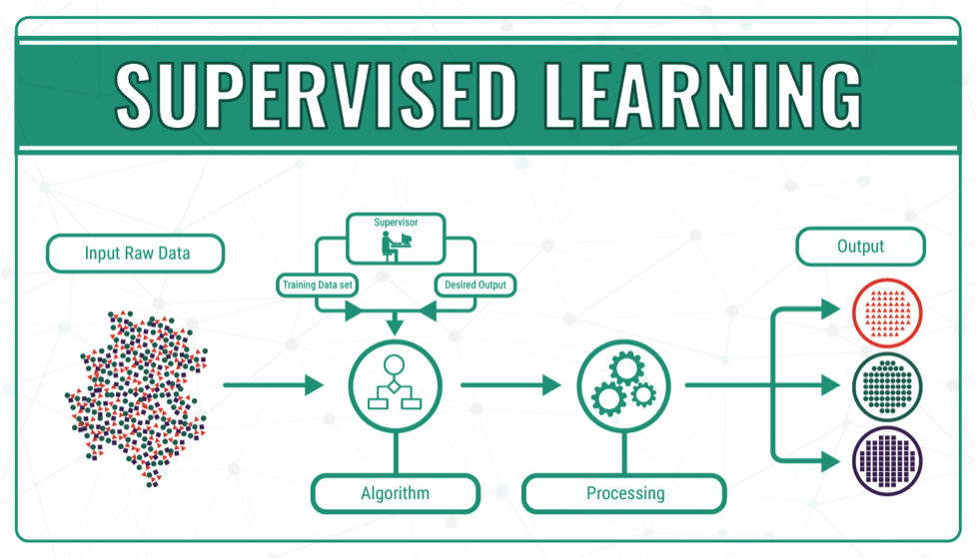
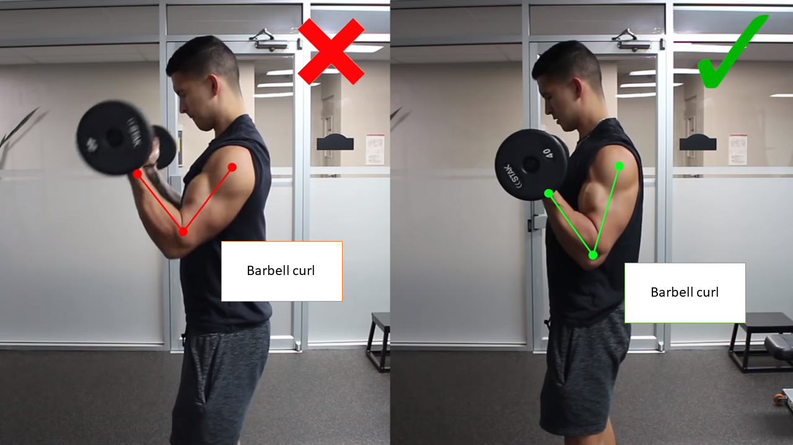
Training AI
X, Y
Training
Multi-person Tracking
Machine learning
Openpose
Supervised Learning
"pose_keypoints_2d":[582.349,507.866,0.845918,746.975,631.307,0.587007,...],
"face_keypoints_2d":[468.725,715.636,0.189116,554.963,652.863,0.665039,...],
"hand_left_keypoints_2d":[746.975,631.307,0.587007,615.659,617.567,0.377899,...],
"hand_right_keypoints_2d":[617.581,472.65,0.797508,0,0,0,723.431,462.783,0.88765,...]
"pose_keypoints_3d":[582.349,507.866,507.866,0.845918,507.866,746.975,631.307,0.587007,...],
"face_keypoints_3d":[468.725,715.636,715.636,0.189116,715.636,554.963,652.863,0.665039,...],
"hand_left_keypoints_3d":[746.975,631.307,631.307,0.587007,631.307,615.659,617.567,0.377899,...],
"hand_right_keypoints_3d":[617.581,472.65,472.65,0.797508,472.65,0,0,0,723.431,462.783,0.88765,...]
Data

Slide 9

เพิ่มท่าออกกำลังกาย
ตรวจสอบท่าทางใน
การออกกำลังกาย
ลบท่าออกกำลังกาย
ผู้ใช้
ผู้ดูแลระบบ
แก้ไขท่าออกกำลังกาย

Slide 10
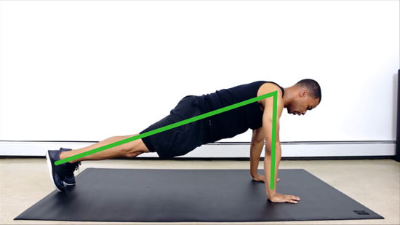
Input
(Webcam , Pictures , Vdo)
(Desktop application)
Process
(AI)
Output

Slide 11
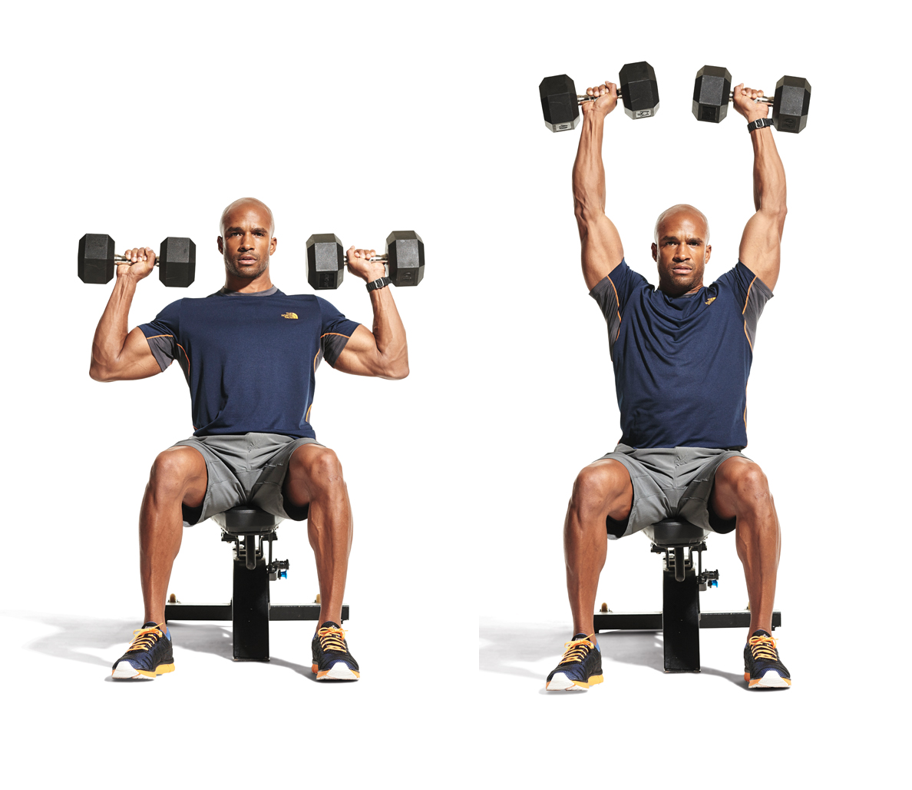
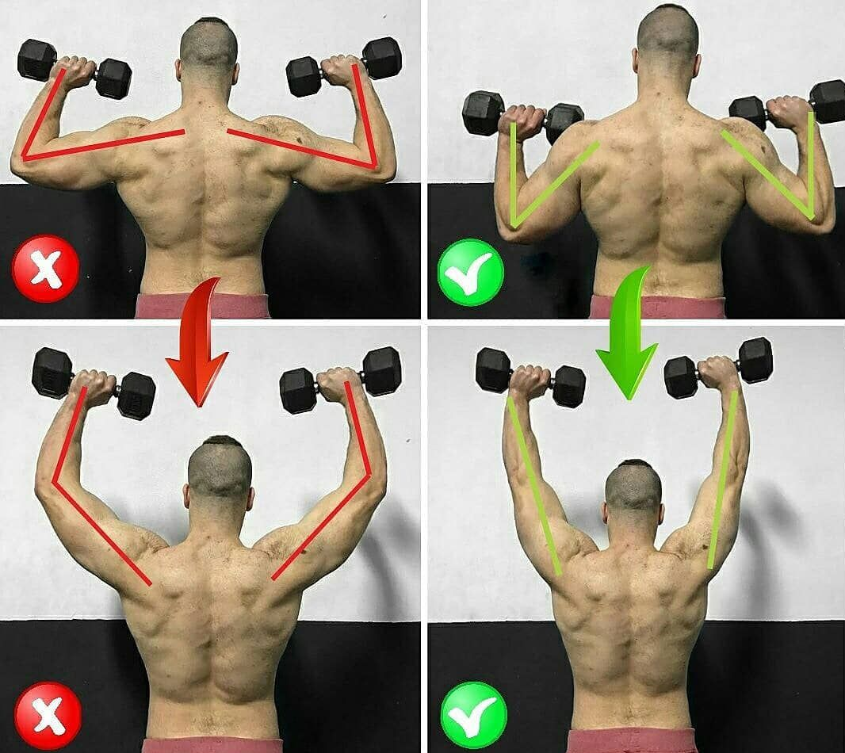
Input
(Webcam , Pictures , Vdo)
(Desktop application)
Process
(AI)
Output

Slide 12
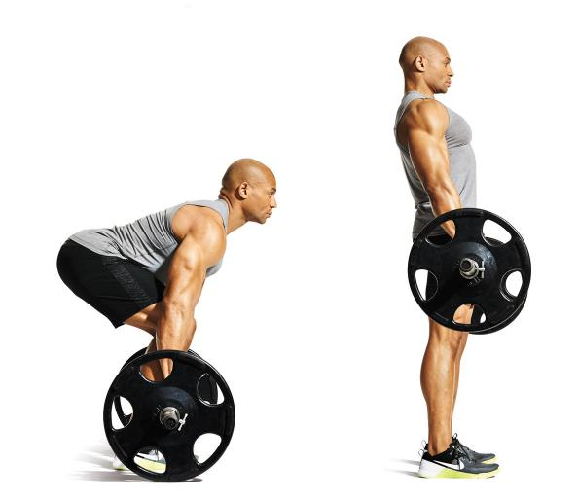
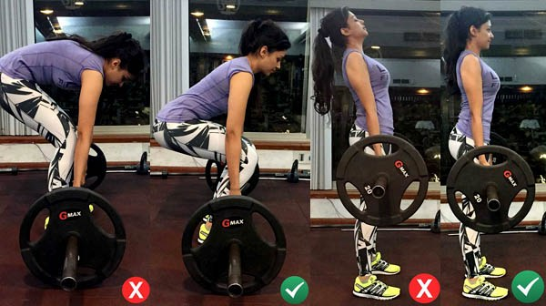
Input
(Webcam , Pictures , Vdo)
(Desktop application)
Process
(AI)
Output

Slide 13
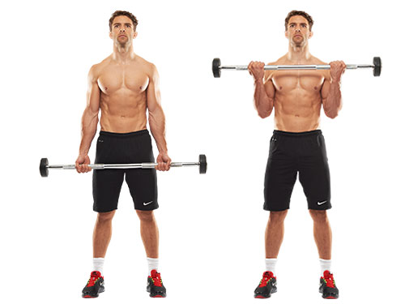
Input
(Webcam , Pictures , Vdo)
(Desktop application)
Process
(AI)
Output

Slide 14
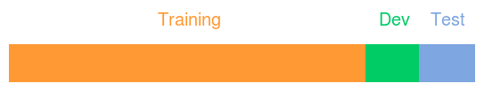
การแบ่งข้อมูล
Training set แบ่งข้อมูล 80 % เพื่อนำไป สอน model
Development set แบ่งข้อมูล 10 % เพื่อนำไปเลือก model ที่มีค่าผิดพลาดน้อยที่สุด
Test set แบ่งข้อมูล 10 % เพื่อนำไปทดสอบ model ว่ามีประสิทธิภาพหรือไม่

